Slide 1

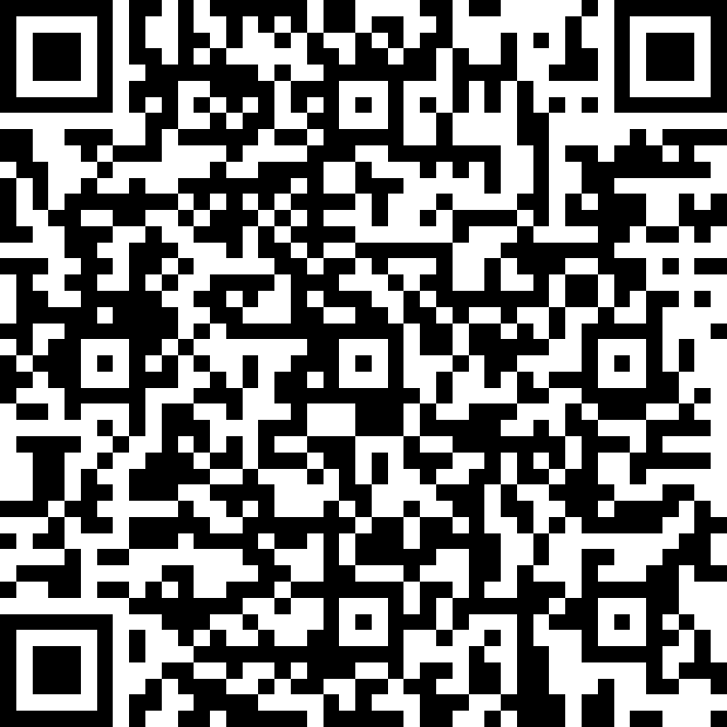
Microsoft Entra ID Governance POC Feedback
https://aka.ms/IGAPOCSurvey

Slide 2
Microsoft Entra ID Governance
Assign Employee access to resources
Proof of concept – Pre-work Call
<<Subtitle or speaker name>>

Slide 3
Proof of concept (PoC) | Goals
Assign Employee access to resources and Recertification
Demonstrate the value of Microsoft Entra ID Governance in your environment:
Discovery: Identify current lifecycle and governance processes for providing access to applications and groups as well as certification of such access
Define: On a successful completed lifecycle of app assignments and certifications
Evaluate: the result of the POC by collecting customer feedback and team insights

Slide 4
Scenario’s Key Requirements
Make sure you meet these requirements to avoid any roadblocks
Microsoft Entra ID P1 or P2 license
Microsoft Entra ID Governance SKU (Logic Apps and Auto Assignment Policies) - How to start a Microsoft Entra ID Governance Trial)
Azure Active Directory Tenants
A cloud user account on the target tenant to approve and access
A cloud user on the Source tenant to request Access
Account with User administrator, Identity Governance Administrator, Privileged Role Administrator or Global administrator on the target tenant

Slide 5
PoC Stakeholders
Common customer stakeholders
We will engage the following stakeholders at specific stages of the POC:
Identity team: Microsoft Entra ID Global Administrator
Azure logic app contributor (or similar)
Security Admin
Development Teams (Graph API, Custom workflows)
Microsoft stakeholder
PoC driver: Microsoft engineer who will guide you during the PoC process

Slide 6
PoC | Timeline
Delivery stages
Entitlement Management
Auto-assignment policies
Custom extensions
Access Recertification
Close-out
1 hour
1 hour
2 hours
2 hours
1 hour
7 hours
Logistics
Each stage will only require participation of a subset of stakeholders from customer
Times are estimated based on scenario complexity

Slide 7
PoC | Phase 1: Entitlement Management
Entitlement Management
Auto-assignment policies
Custom extensions
Access Recertification
Close-out
1 hours
1 hour
2 hours
2 hours
1 hour
Session (1 hour): Entitlement Management
Who? → All teams
Working session
2 hours, depending on complexity of scenario
Role | Responsibility
Microsoft Entra ID Global Admin | →Configure connected Organization and Access Package
Security Admin | →Ensure solution meets organizational security policies
Compliance Manager | → Ensure solutions complies with regulations

Slide 8
PoC | Phase 2: Auto-assignment policies
Entitlement Management
Auto-assignment policies
Custom extensions
Access Recertification
Close-out
1 hours
1 hour
2 hours
2 hours
1 hour
Session (2 hour): Auto-assignment policies
Who? → All teams
Working session
2 hours, depending on complexity of scenario
Role | Responsibility
Microsoft Entra ID Global Admin | →Configure Access Package
Security Admin | →Ensure solution meets organizational security policies
Compliance Manager | → Ensure solutions complies with regulations

Slide 9
PoC | Phase 3: Custom Extensions
Entitlement Management
Auto-assignment policies
Custom extensions
Access Recertification
Close-out
1 hours
1 hour
2 hour
2 hours
1 hour
Session (1 hour): Custom extensions
Who? → All teams
Working session
1 hour, depending on complexity of scenario
Role | Responsibility
Microsoft Entra ID Global Admin | →Configure Access Package
Security Admin | →Ensure solution meets organizational security policies
Compliance Manager | → Ensure solutions complies with regulations
Development Teams | → Assist on build applications like custom workflows

Slide 10
PoC | Phase 4: Access Recertification
Entitlement Management
Auto-assignment policies
Custom extensions
Access Recertification
Close-out
1 hour
1 hour
2 hours
2 hours
1 hour
Session (1 hour): Access Recertification
Who? → All teams
Working session
1 hour, depending on complexity of scenario
Role | Responsibility
Microsoft Entra ID Global Admin | →Configure Access Package
Security Admin | →Ensure solution meets organizational security policies
Compliance Manager | → Ensure solutions complies with regulations

Slide 11
PoC | Phase 5: Close-out
Entitlement Management
Auto-assignment policies
Custom extensions
Access Recertification
Close-out
1 hour
1 hour
2 hours
2 hours
1 hour
Wrap-up session (1 hour)
Who?
→ All teams
→ Leadership team
Goal
Present POC results
Discuss strategy to further implement
Fill out PoC closeout survey

Slide 12
Microsoft Entra ID Governance features used on this scenario
Feature | Description | Stage | Governance SKU
Entitlement Management (EM) | Enables organizations to manage identity and access lifecycle at scale, by automating access request workflows, access assignments, reviews, and expiration. | General Availability | No
EM + Custom Extensions (Logic Apps) | Logic Apps with entitlement management can expand governance workflows beyond the core entitlement management use cases. | General Availability | Yes
EM + Auto assignment policies | Use rules to determine access package assignment based on user properties in Azure Active Directory (Microsoft Entra ID) | General Availability | Yes
AR - Inactive Users | Review and address stale accounts that haven’t been active for a specified period on a regular basis. | General Availability | Yes
AR - Machine learning assisted access certifications and reviews | Provides ML-based recommendations to the reviewers of an access review based on the organization’s reporting structure. | General Availability | Yes
AR - PIM For Groups | Review access for PIM for Groups on a regular basis. | Public preview | Yes
Source
Microsoft Entra ID Governance licensing fundamentals
Notes:
The following governance features went GA and are part of the Microsoft Entra ID Governance SKU:
Lifecycle workflows (LCW) – Enables you to use custom workflows to automate identity lifecycle management tasks for your Microsoft Entra ID users by managing your joiner, mover, and leaver lifecycle processes. With LCW, you can leverage Microsoft Entra ID to confidently deploy workflows to configure out-of-the-box actions to onboard and offboard your employees.
LCW + Custom Extensions (Logic Apps) - Lifecycle Workflows can be used to trigger custom tasks via an extension to Azure Logic Apps.

Slide 13
Microsoft Entra ID Governance
Assign Employee access to resources
Proof of concept deployment
<<Subtitle or speaker name>>

Slide 14




















Contoso’s user journey
Life Cycle Automation
Just-in-time access, alerts, and approval workflows to protect access to critical resources
Self-Service access request when additional access is needed
Onboard the user into the directory when the user joins or start working with Contoso
Teams sites
SharePoint Libraries
Automate the granting of access rights to resources
Make sure access rights are removed when user leaves or stops working with Contoso
SaaS apps
Access recertification
to reduce risk
On-premises apps
Ongoing auditing & reporting

Slide 15



Access requests, workflow and approvals Entitlement management
User
onboarded
Give users self-service access requests for resources and automate approval workflows and access assignment, reviews, and expiration for all human identity types (users, guests, etc.)
Self-service policy and workflow can be defined by app, group or site owners
Supports multi-stage approval workflows, separation of duties enforcement, and recurring access recertification
Supports custom workflows for access lifecycle (through Logic Apps integration)
Access time-limited, guests removed when last access expires
Job
changes
Request
(additional)
access
Ongoing auditing & reporting
Review and revise
Provision
access

Slide 16






Request and provisioning workflow integrations Custom workflows for access lifecycle
Public preview
Access packages and policies
Azure Logic Apps
Additional integrations
Custom approval workflows Finer-grained per-app role provisioning Ticketed provisioning for disconnected apps Custom notifications
When access requested
When access approved
Access granted actions
Access removed actions
Business apps
No/low-code workflow
ITSM
SCIM, LDAP, SQL, and more
Notes:
New video series, creating and using Entitlement Management Custom Extensions for Access Packages https://www.youtube.com/watch?v=tl1GZ_JGMBk

Slide 17
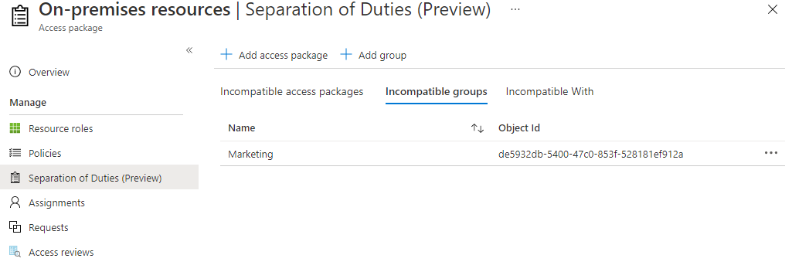
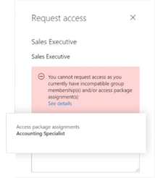
Separation of Duties
Restrict users from requesting an access package
if they already have an assignment to another access package, or
if they are a member of a group
Report on users who have incompatible access rights
Alert on users receiving access directly to applications
Notes:
In each of an access package's policies, you can specify who is able to request that access package, such as all member users in your organization, or only users who are already a member of a particular group. However, you may wish to further restrict access, in order to avoid a user from obtaining excessive access. With the separation of duties settings on an access package, you can configure that a user cannot request an access package, if they already have an assignment to another access package or are a member of a group.
For example, you have an access package, Marketing Campaign, that people across your organization and other organizations can request access to, to work with your organization's marketing department on that marketing campaign. Since employees in the marketing department should already have access to that marketing campaign material, you wouldn't want employees in the marketing department to request access to that access package. Or, you may already have a dynamic group, Marketing department employees, with all of the marketing employees in it. You could indicate that the access package is incompatible with the membership of that dynamic group. Then, if a marketing department employee is looking for an access package to request, they couldn't request access to the Marketing campaign access package.

Slide 18
Auto assignment Rules

Slide 19
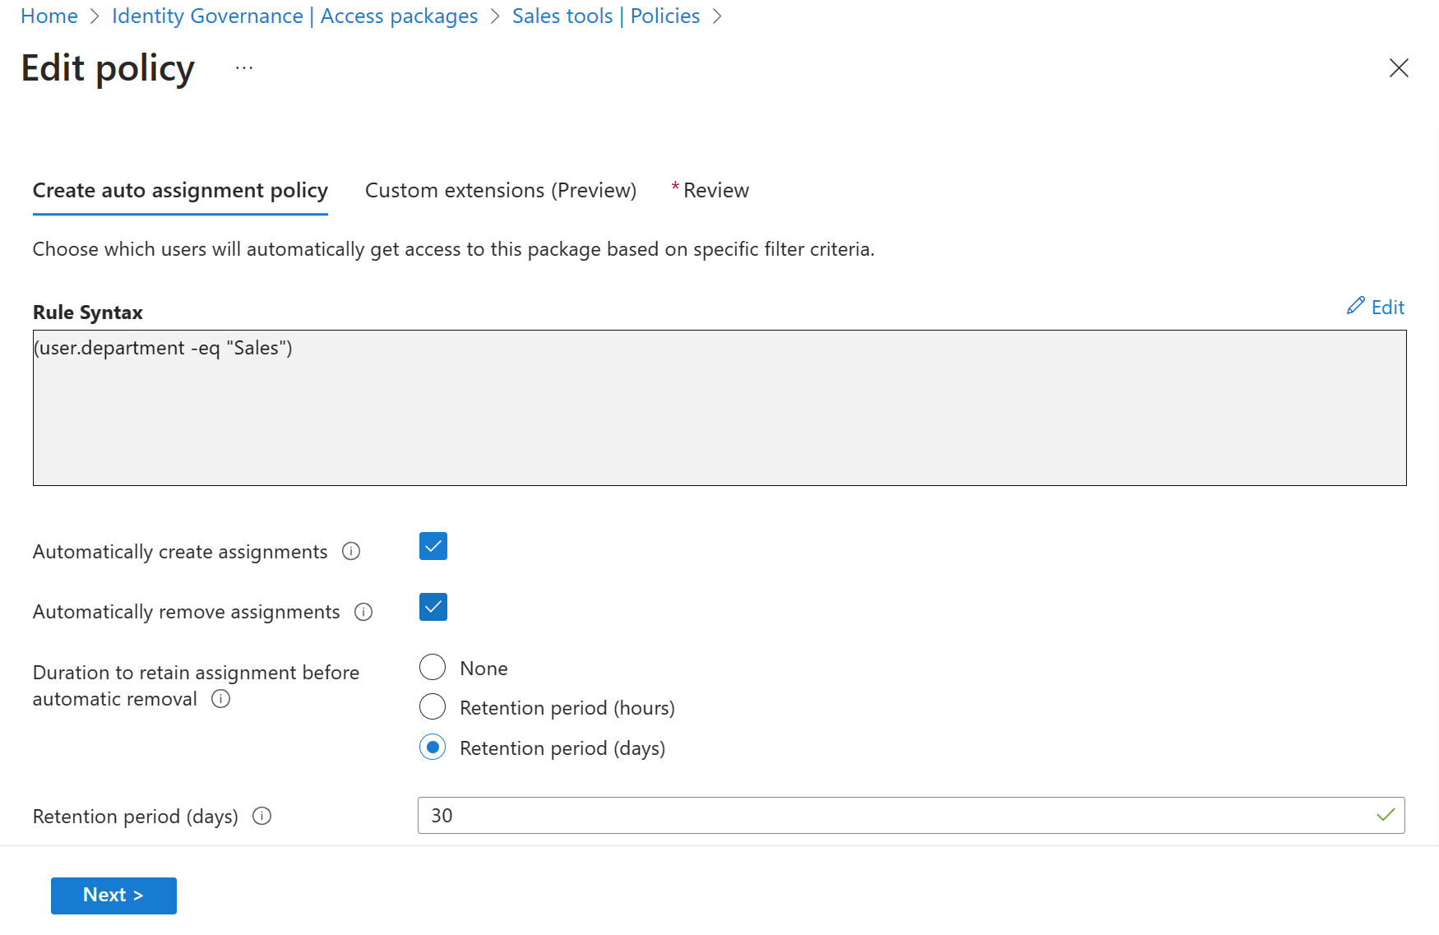
Assign and remove resources automatically Birthright assignment
Use rules to determine access package assignment based on user properties, similar to dynamic groups.
Assignments to users are added or removed depending on whether they meet the rule criteria.

Slide 20
Features
Automatically create assignments: Add the user when an user properties matches with the policy's membership rule
Automatically remove assignments : Remove the user when an user properties matches with the policy's membership rule

Slide 21
Planning- Decisions to consider
-Access Package name and description
-Define if this Access Package will have approval stages. If it does, define approvers and requestors.
-Attribute(s) for the Business rule definición
-Automatically create assignment
-Automatically remove assignment

Slide 22
Deploy
Step | Instructions
Create an Access Package | Create an access package in entitlement management
Create auto assignment policy | Create an automatic assignment policy
Detailed Step by step
Configure an automatic assignment policy for an access package in entitlement management - Microsoft Entra | Microsoft Learn

Slide 23
Custom Workflows with Logic Apps

Slide 24
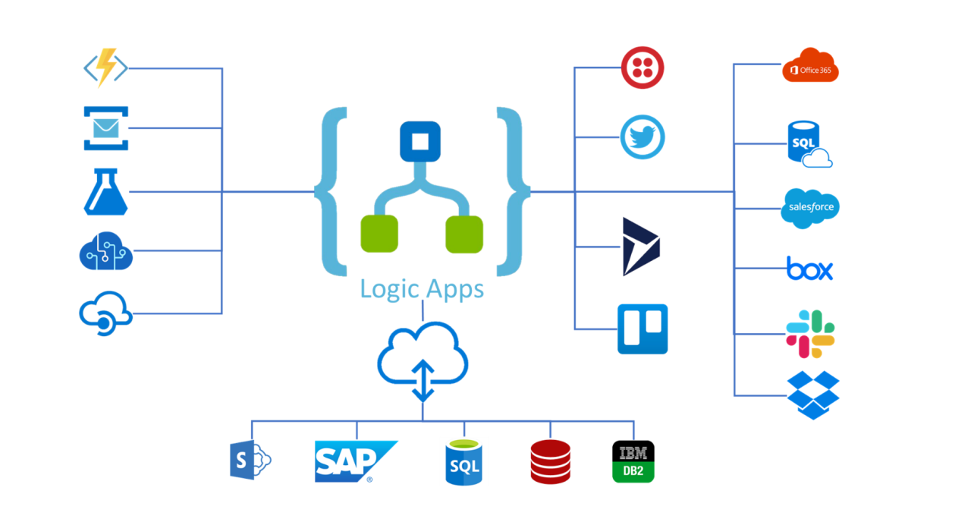
What is a Logic App?
Azure Logic Apps is a cloud platform where you can create and run automated workflows with little to no code. By using the visual designer and selecting from prebuilt operations, you can quickly build a workflow that integrates and manages your apps, data, services, and systems.

Slide 25
Logic App Integration with Entitlement Management
Used to automate custom workflows and connect apps and services in one place. Users can integrate Logic Apps with entitlement management to broaden their governance workflows beyond the core entitlement management use cases.
When an access package request is created
When an access package request is approved
When an access package assignment is granted
When an access package assignment is removed
14 days before an access package assignment auto expires
One day before an access package assignment auto expires

Slide 26
Use cases examples
Send custom email Notifications
Send Teams notification
Get user information from other applications
Writeback user information to external systems
Call an External web api to trigger actions on external systems
Creating a set of tasks in Microsoft planner
Generate a TAP

Slide 27
Planning- Decisions to consider
Processes that you need to automate during the different request stages
Interfaces available on Target systems
Request stage where you want to trigger the logic app
Have Azure Subscription Resources available
Logic App authentication with target systems

Slide 28
Deploy
Step | Instructions
1. Add custom Extension to a Catalog | Create and add a Logic App workflow to a catalog for use in entitlement management
2. Edit the Custom Extension | Edit a linked Logic App's workflow definition
3. Add custom Extension to an Access Package | Add custom extension to a policy in an access package
Detailed Step by step
Trigger Logic Apps with custom extensions in entitlement management - Microsoft Entra | Microsoft Learn

Slide 29



Scenario: Access Recertification
Joiner / Mover / Leaver
Microsoft Entra ID P2
Access Reviews - Basic access certifications and reviews
Microsoft Entra ID Governance:
Access Reviews targeting inactive identities
Certify PIM for Groups memberships
Machine Learning assisted recommendations
Access Lifecycle Management
Access Recertification
Identity
Secure privileged access for administration

Slide 30

Access recertification to reduce risk Access Reviews
Natively built-in to Microsoft Entra
Manage risk and meet compliance for users, guests and workload identities
Ensure access to sensitive Teams, Groups, Apps, Roles is reviewed periodically

Slide 31
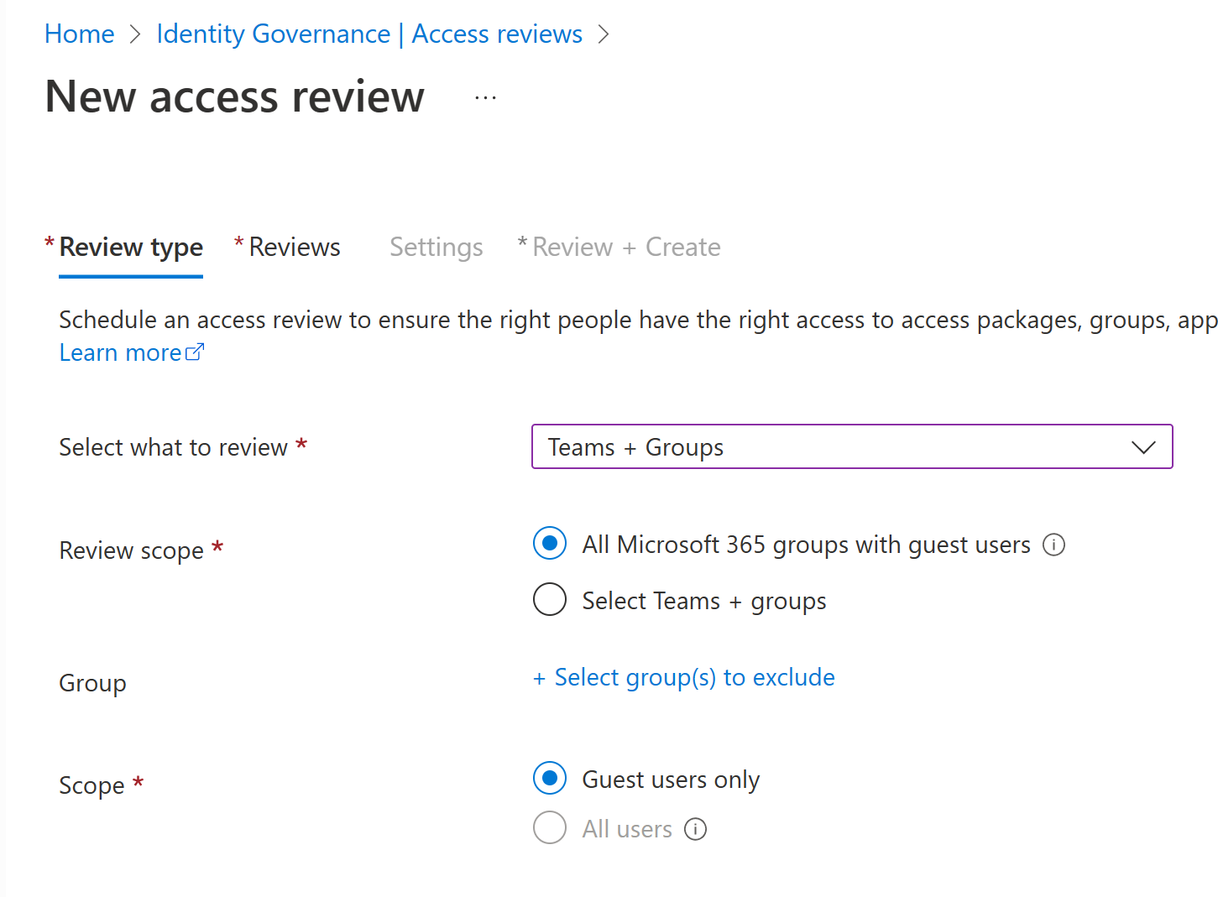
How Access Reviews works Administrator
1. Selects resource
2. Selects scope
Team/Group
SaaS application
Privileged role
Access Package
Guests
Employees
Everyone
Workload Identities
3. Selects reviewer
4. Selects frequency
Team/Group owner
Manager
Specific user(s)
Users’ self review
Weekly
Monthly
Quarterly
Yearly

Slide 32
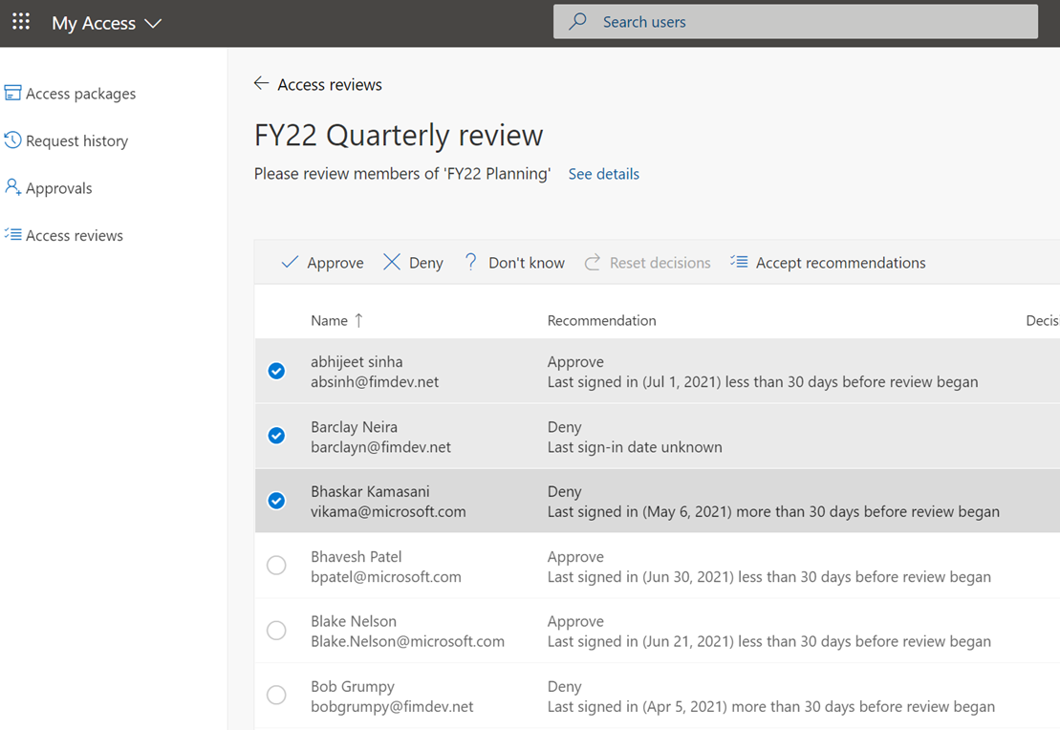
How Access Reviews works Reviewer
1. Send notification
2. Review
Email is sent to the reviewer
Review current membership with system generated recommendations
3. Confirm
4. Apply result
Reviewers confirm which memberships to keep
Denied users are removed from the resource

Slide 33


Access Reviews Scenarios
Employees | External Users
Change jobs or leave the company Employee's previous access are not removed. Users accumulate excessive permissions | Guests invited into the tenant What access should they have? When should they leave?
B2B
Notes:
Employees:
Forget to remove employee's previous access rights.
Users accumulate excessive permissions, increasing risk and the likelihood of audit findings.
Make sure you exclusion groups in CA are always reviewed: https://docs.microsoft.com/en-us/azure/active-directory/governance/conditional-access-exclusion

Slide 34
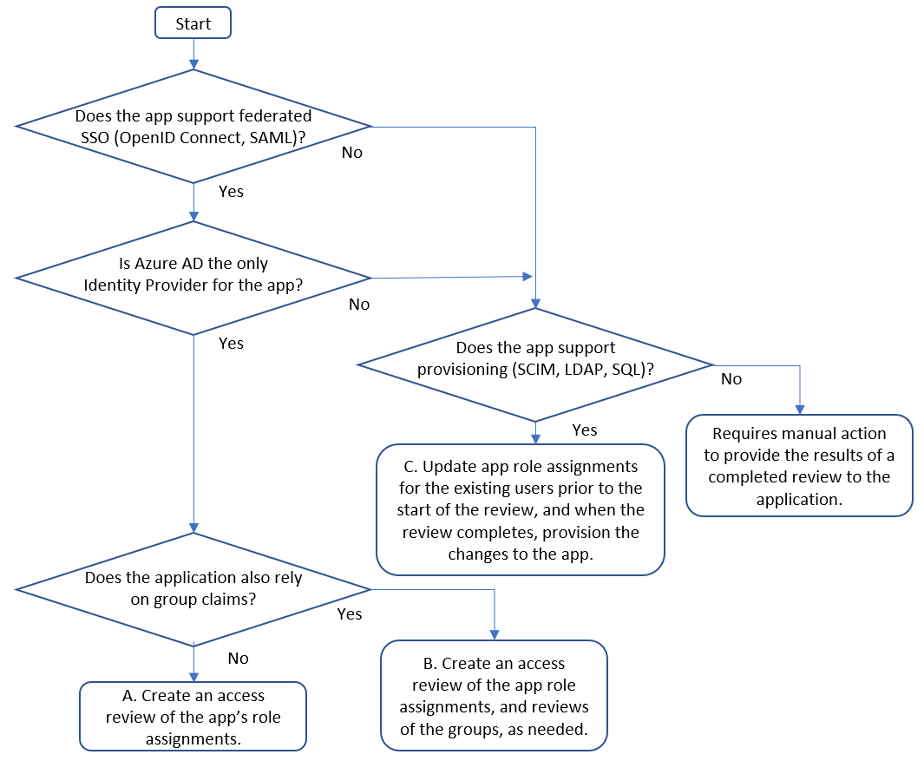
Planning
Determine application readiness

Slide 35
Planning- Decisions to consider
1. Who is responsible for the review?
A. Users review their own privilege​
Schedule access review to ask users themselves if they still need access.
Remove privilege if the user denies or does not respond.​
​B. Resource owners review privileges assigned to their resources.​
Schedule access review to ask resource owners to review the privileges assigned to their resource.
Possible Reviewers:
Group Owners
Specific Users
Managers of Users

Slide 36
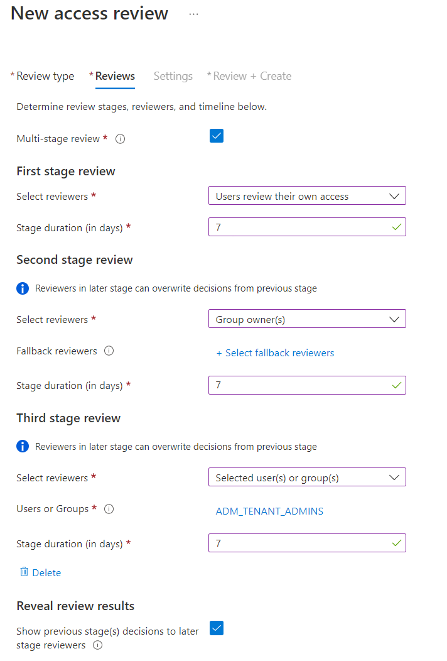
Planning (Contd)
2. How many stages of reviews are needed?
Reach consensus across multiple sets of reviewers
Assign alternate reviewers to weigh in on unreviewed decisions
Reduce burden on later stage reviewers

Slide 37
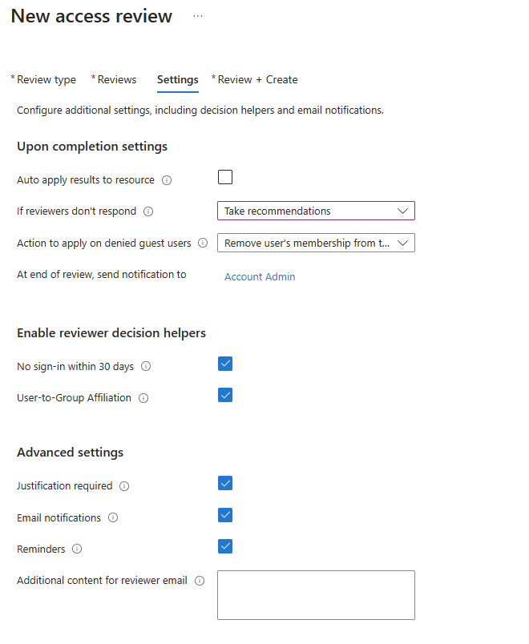
Planning (Contd)
3. Decide on criteria for automated decisions
Response Triggers
Account Inactivity
Justification requirements
Alerting and notifications

Slide 38
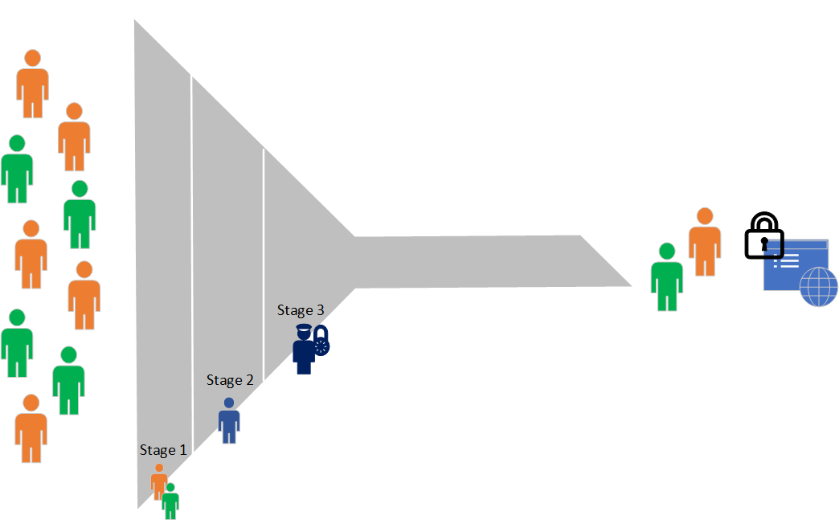
Multi-Stage Reviews Decisions
First stage reviewers?
Select user(s) or group(s) – the owner(s) of the applications
Second stage reviewers?
Managers of users
Show previous stage(s) decisions to later stage reviewers?
Which reviewees go to the next stage?
Expected action on non-response?
Approve/Deny

Slide 39
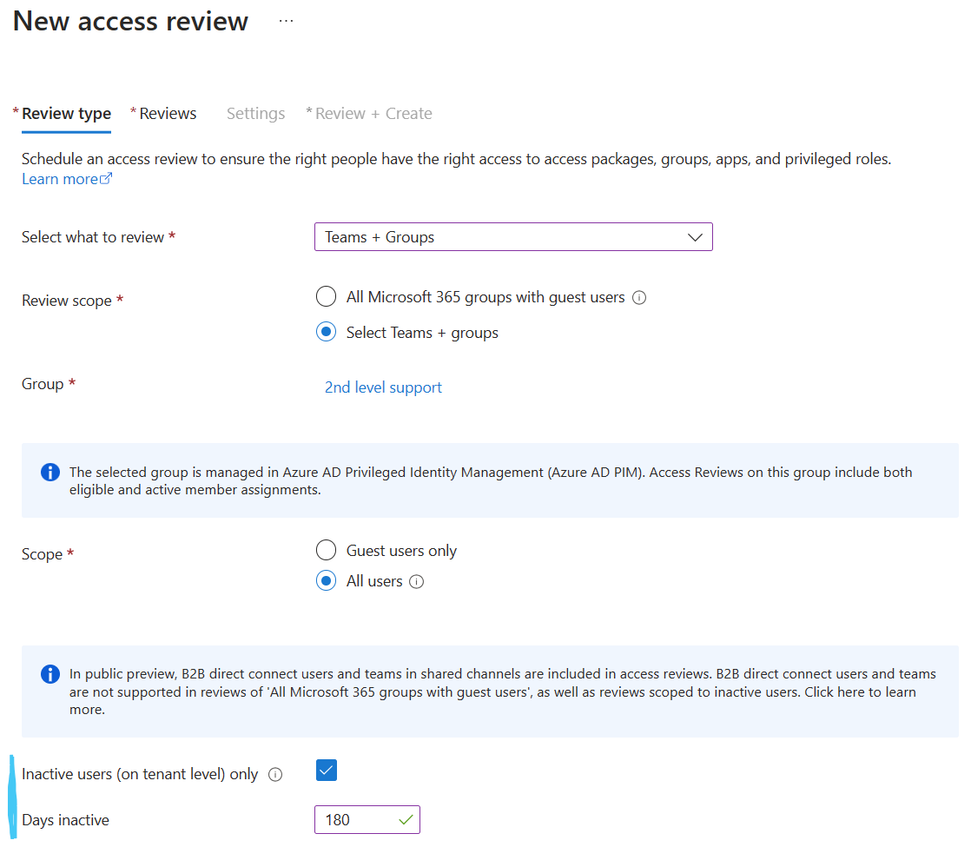
AR – Inactive Users General Availability
Review inactive users
Review and address stale accounts that haven’t been active for a specified period
Includes interactive and non-interactive sign-ins
You define what inactive means
Automatically remove stale accounts
Notes:
Source: Review inactive user accounts

Slide 40




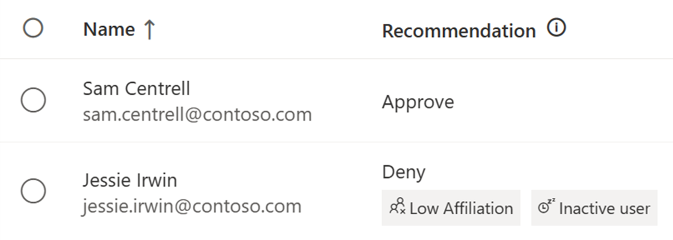



Machine Learning based recommendations in Access Reviews User-to-Group Affiliation
Machine Learning uses organizational distance to calculate group affiliation
Reviewers get data driven recommendations based on last sign in date and group affiliation
Admins create Access Review to protect against breaches and stay compliant
Last sign in activity
Sam Centrell
18 days
Jessie Irwin
125 days
Inactive user recommendation considers activity based on last sign in date
Notes:
Reviewers see the recommendation if a user has Low Affiliation with other users within the group and helps make quicker decisions based on organizational distance between employees.

Slide 41
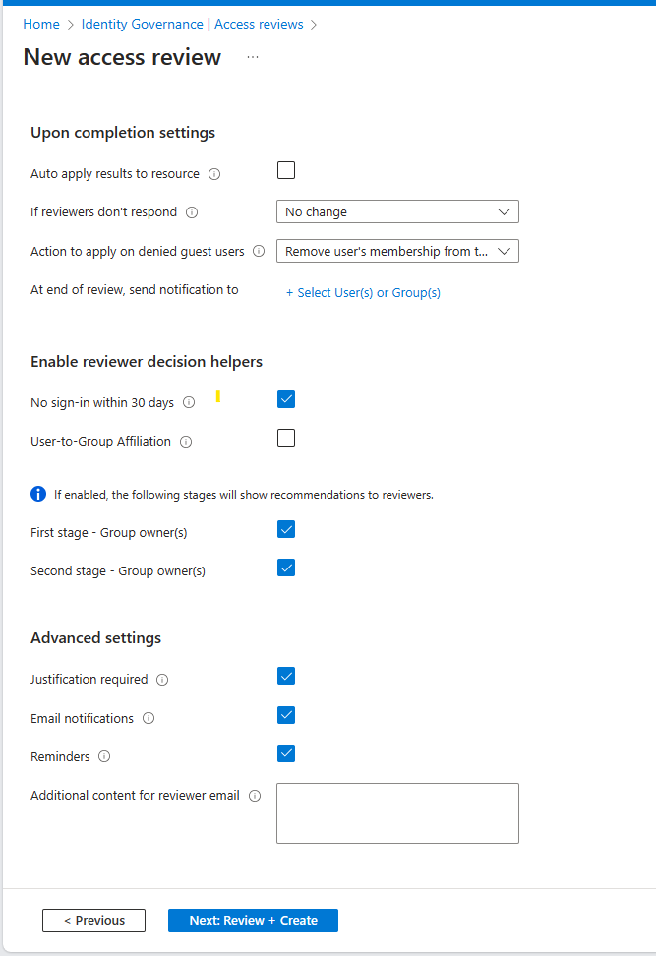
User to Group Affiliation
Detects user affiliation with other users within the group, based on organization's reporting-structure similarity.
Users who are distant from all the other group members based on their organization's chart, are considered to have "low affiliation" within the group.
** Only available for users in your directory.
** A user should have a manager attribute
**Groups with more than 600 users are not supported.
Demo

Slide 42
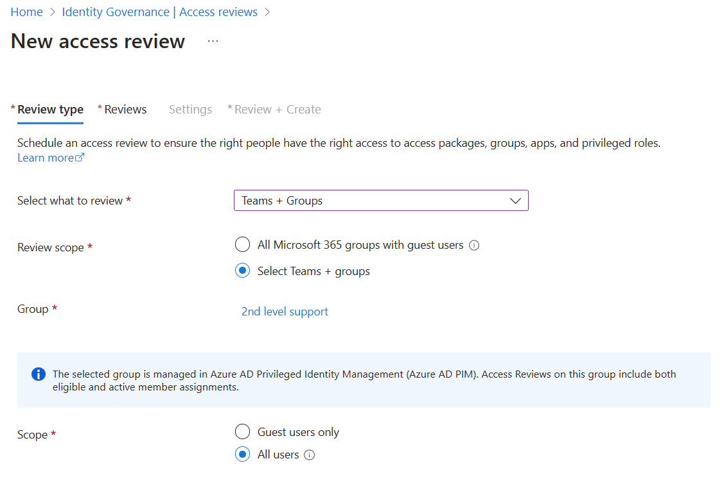
AR – PIM for Groups Public preview
Review access for PIM for Groups
Includes active members of the group and eligible members
Only active owners can be assigned as reviewers
Inactivity of users up to 2 years
Notes:
Source: Review access for PIM for Groups

Slide 43
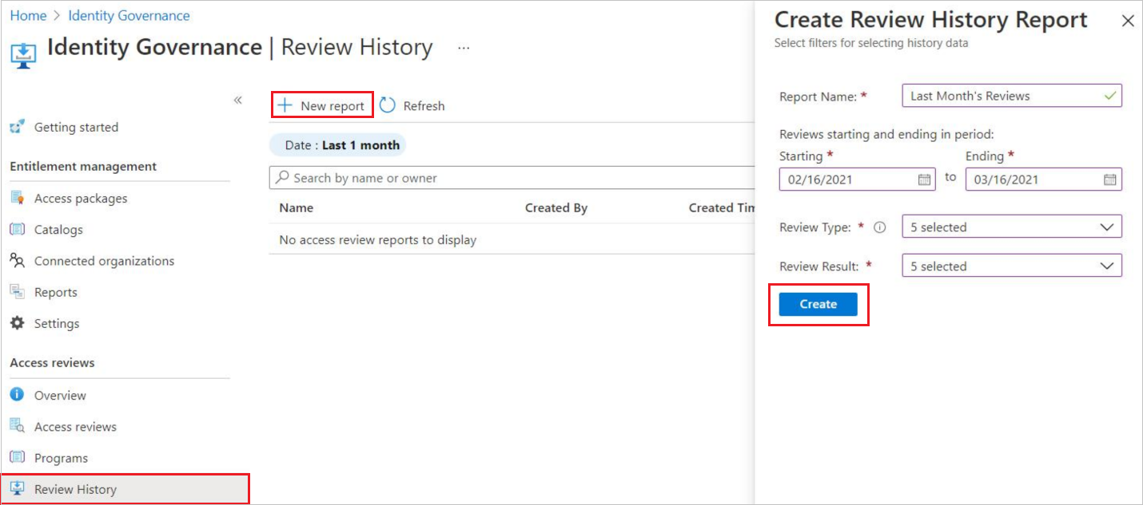
Access Review history report
Downloadable review history to gain more insight on Access Reviews.
Download results for audit and compliance needs, or to integrate with other solutions.
Reports can be constructed to include specific access reviews, for a specific time frame, and can be filtered to include different review types and review result.

Slide 44
Deploying Access Reviews Guide
Scenario | Instructions
Planning an Access Reviews Deployment | Plan a Microsoft Entra access reviews deployment
Access review of PIM for Groups | Create an access review of PIM for Groups (preview)
Access review of Azure resource and Microsoft Entra ID roles in PIM | Complete an access review of Azure resource and Microsoft Entra ID roles in PIM
Access review of an access package | Create an access review of an access package in entitlement management

Slide 45

Thank you

Slide 46
Logic App Example (optional)

Slide 47
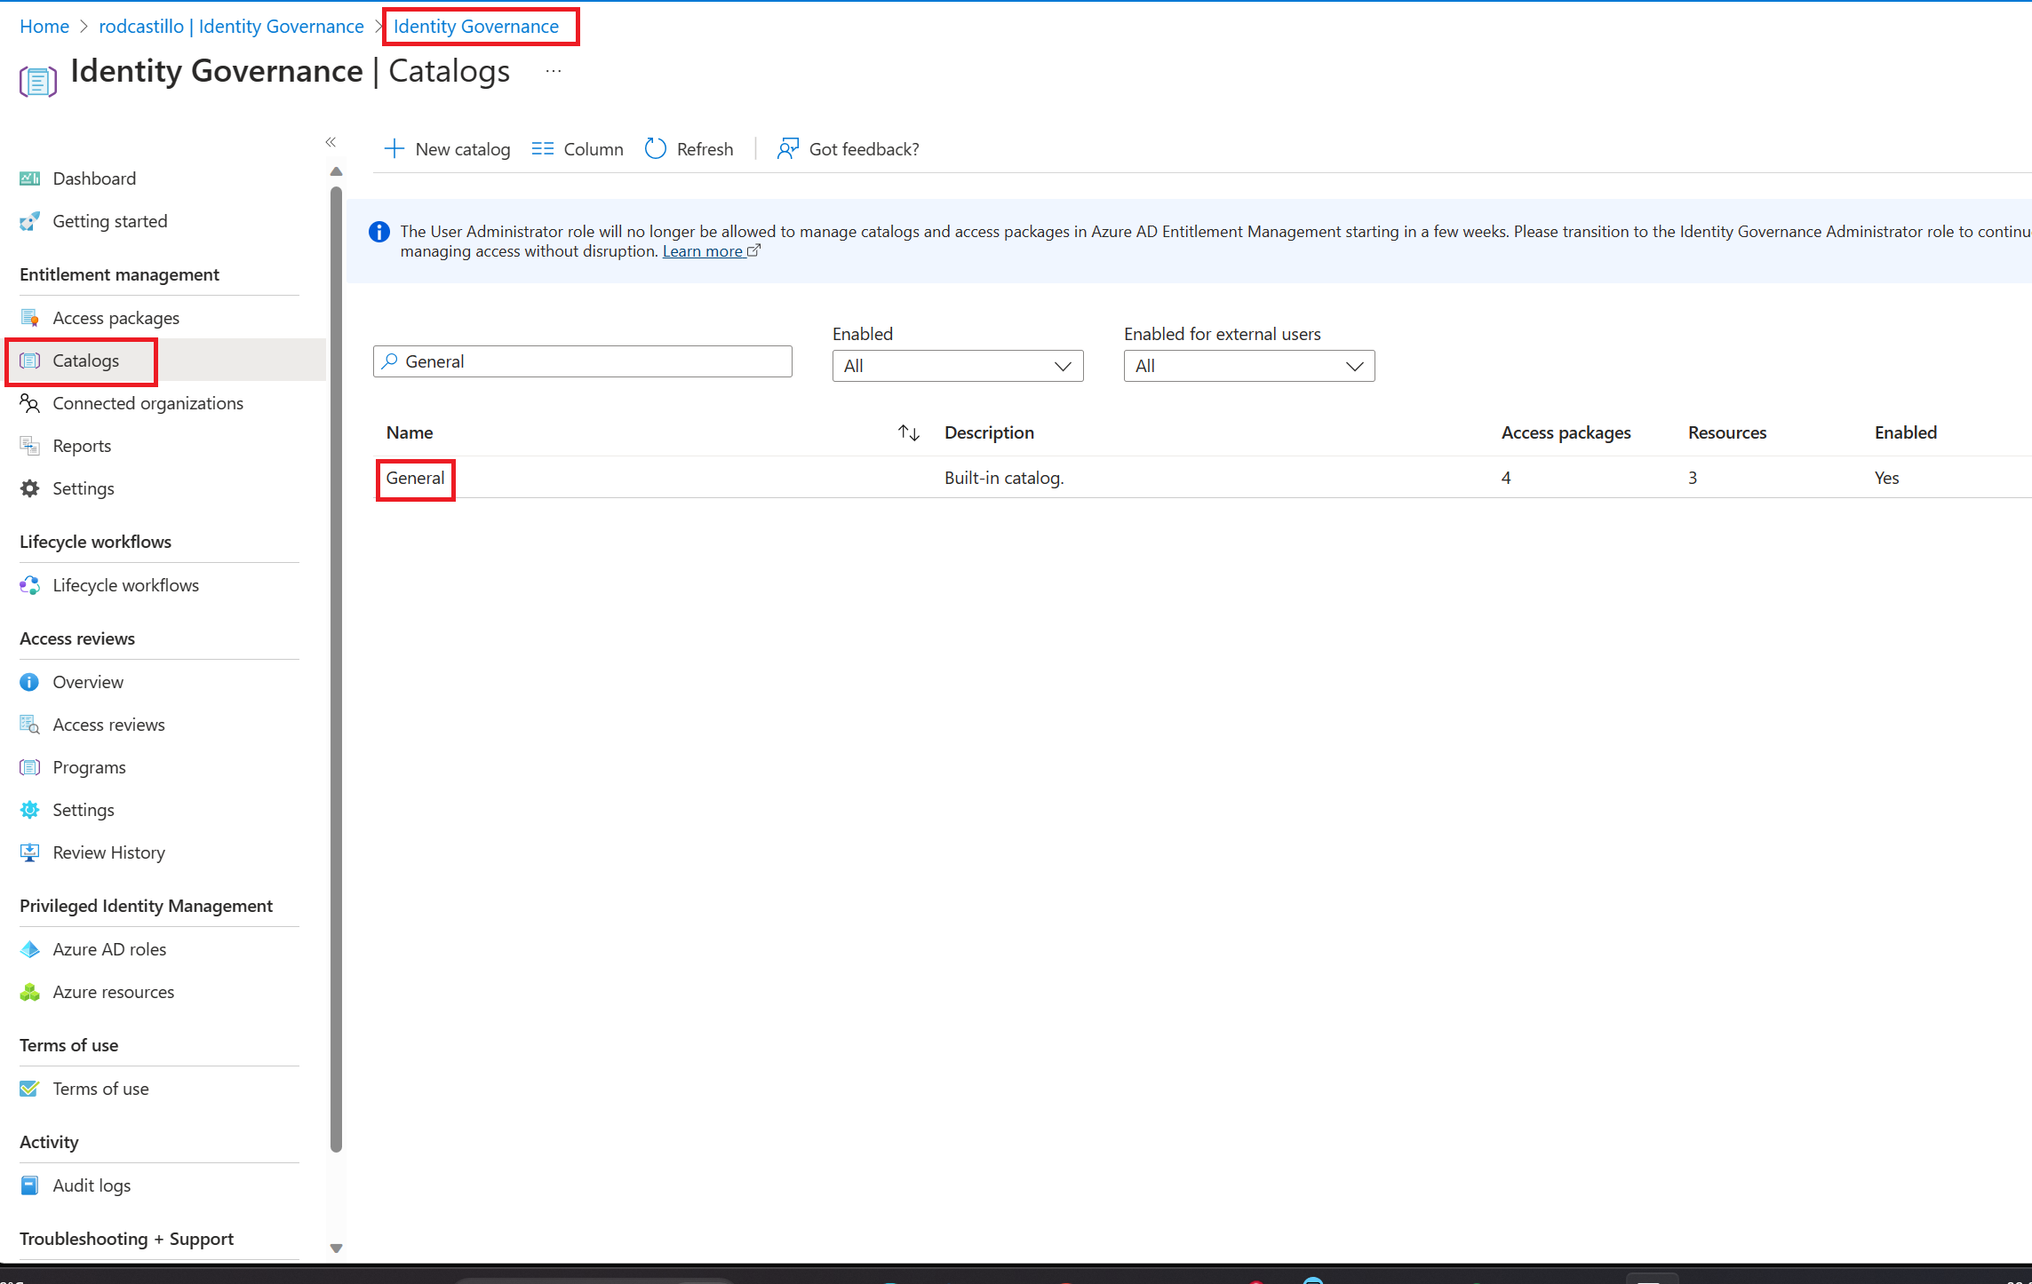
Step 1 Create Logic App
On the Azure portal, go to Azure Active Directory
On the left menu, select Identity Governance.
On the left menu, select Catalogs
On the Catalogs Blade open the General Catalog

Slide 48
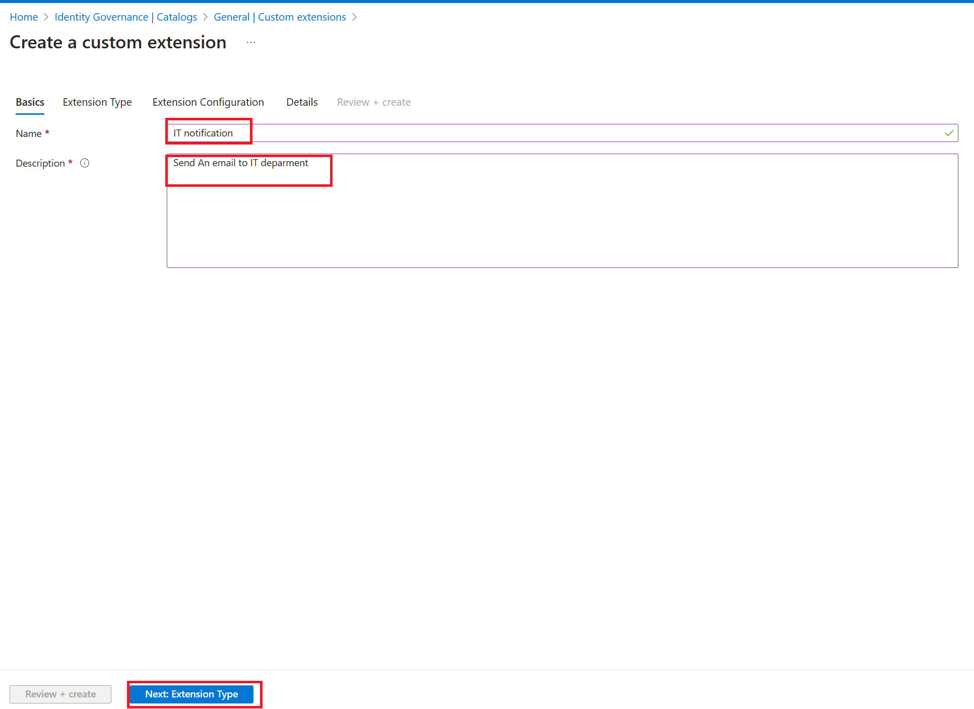
Step 1 Create Logic App
On the General Catalog blade, select Custom Extensions on the left menu
On the Custom Extensions blade, select Add Custom extension.
Write IT Notification as Name and Send an email to IT department and Click on Next

Slide 49
Step 1 Create Logic App
On Extension Type Tab, select Next
On the Extension Configuration, select Next
On the Details tab, Select your Subscription, resource group and write SentITNotification as Logic app name
Select Create Logic App
After the logic app was created, select Review + Create and then Create

Slide 50
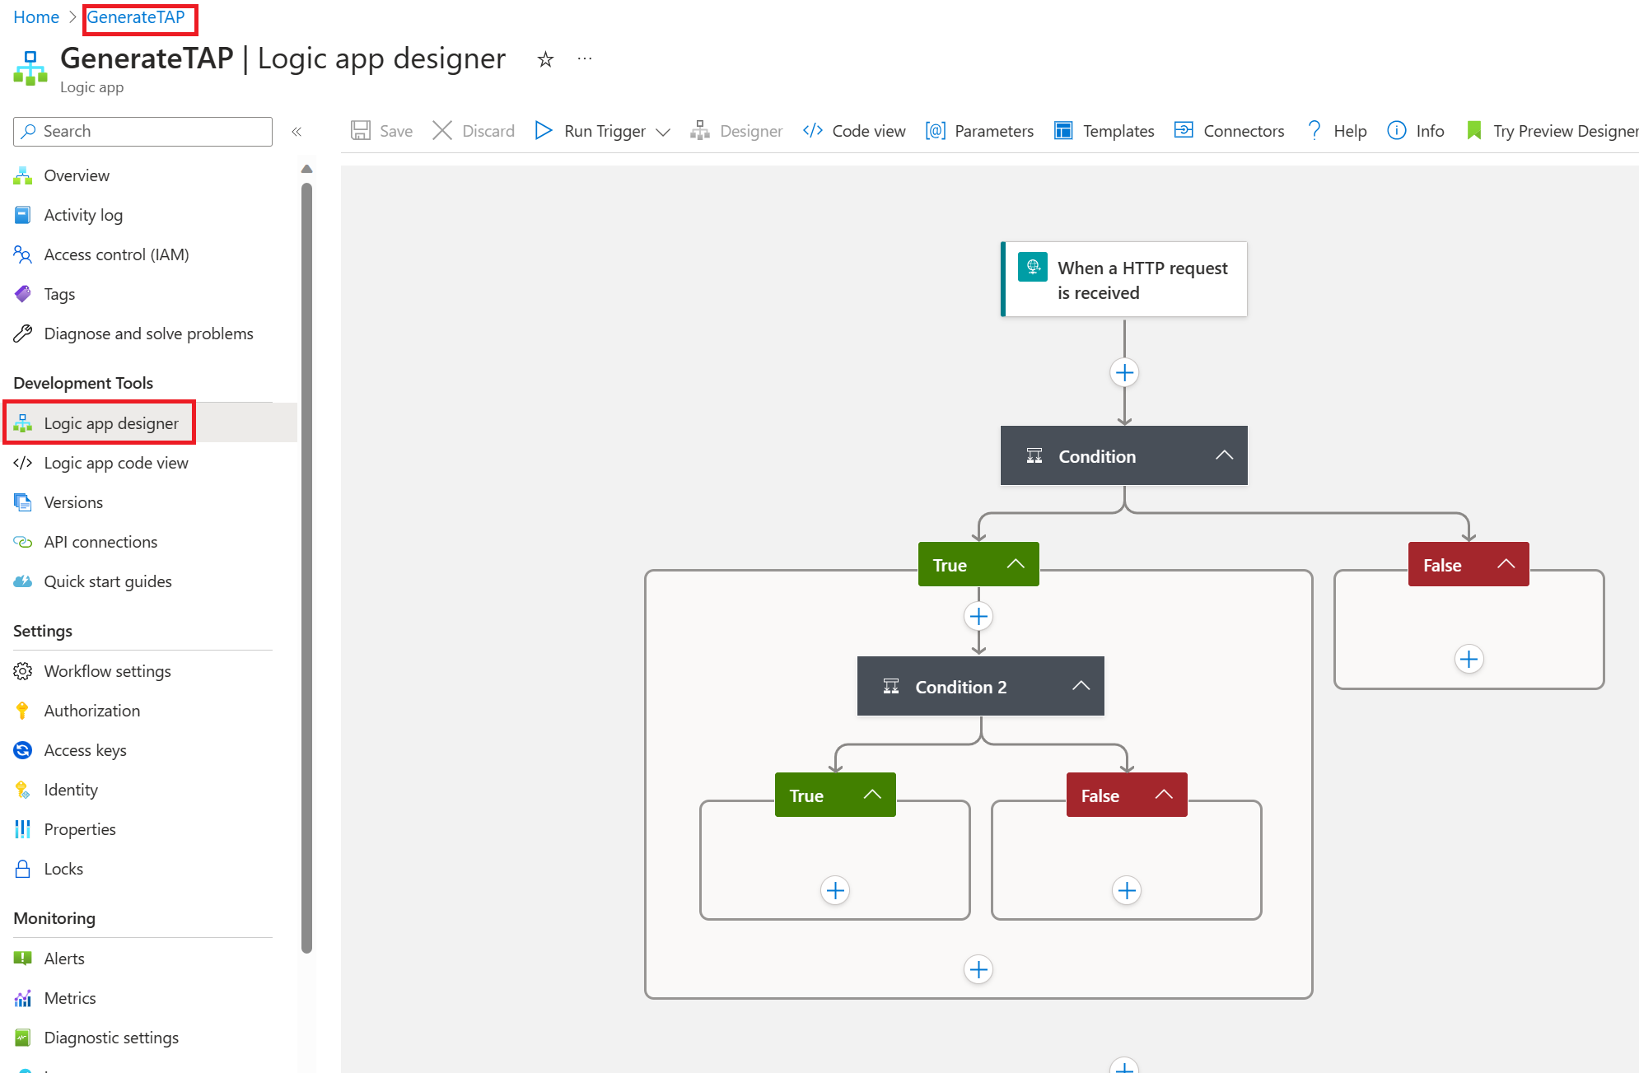
Step 2 Customize Logic App
On The Azure Portal, go to Logic Apps
Open SendITNotification
On the Left Menu, select Logic App designer

Slide 51
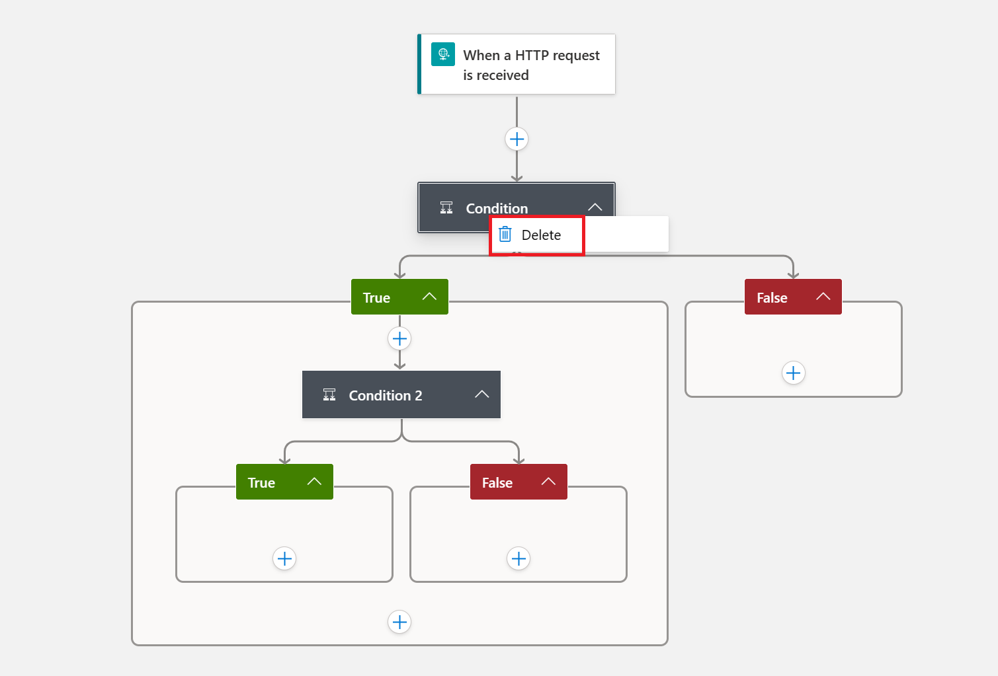
Step 2 Customize Logic App
On the Condition, right click and select delete
After it, only one activity should appear on the Workflow designer

Slide 52
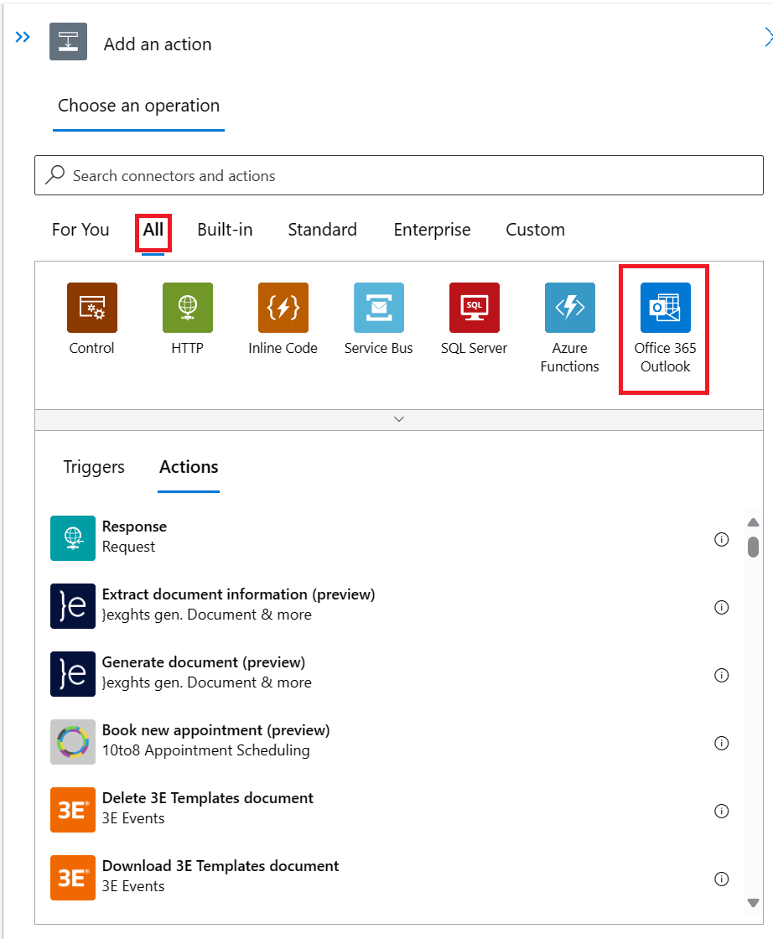

Step 2 Customize Logic App
On the Workflow designer, click on the plus symbol ( )
Select Add an Action
On the Add an Action blade, go to All tab and select Office 365

Slide 53
Step 2 Customize Logic App
On the Actions tab, select Send Email (v2)

Slide 54
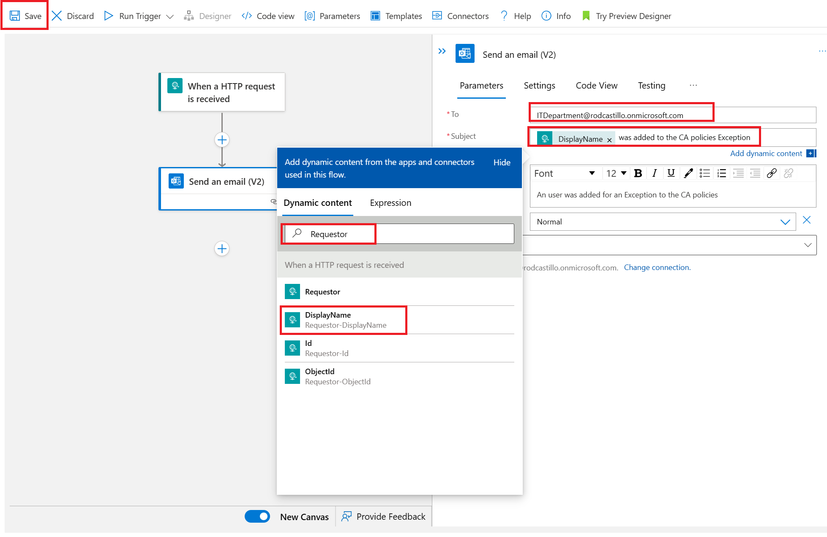
Step 2 Customize Logic App
On send an email Action (v2), write the name of your IT DL as To
Select the subject textbox, clic on the Add dynamic content link, on the add dynamic content window search for Requestor and Select DisplayName
Write An user was added for an Exception to the CA policies as body
Select Save

Slide 55
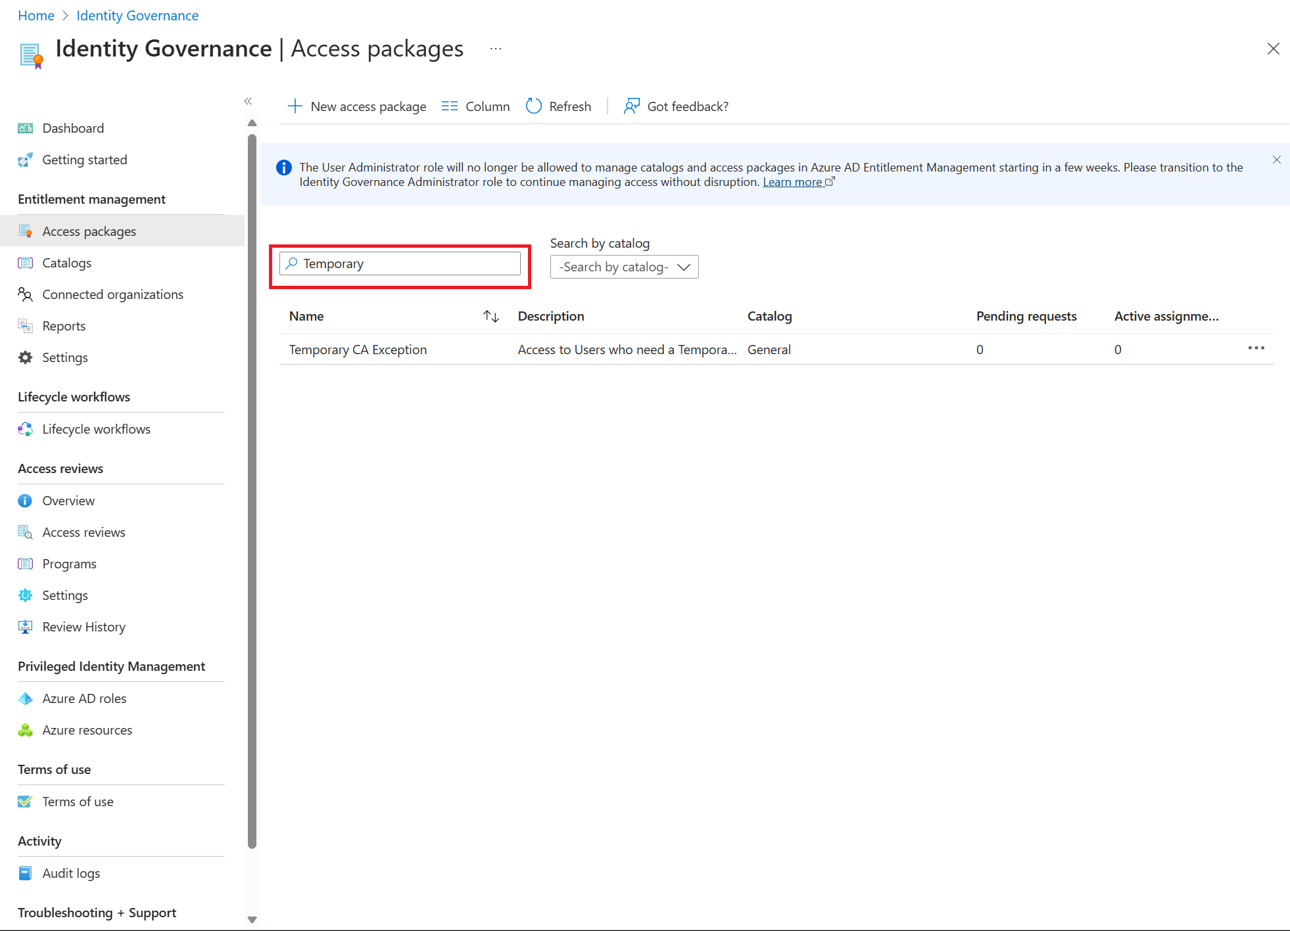
Step 3: Search the existing Access Package
On the Entra portal, in the left navigation, under Identity Governance select Entitlement Management
On the left menu, select Access packages.
On the search bar, write temporary and press Enter to get the access package created on the past scenario
Open it

Slide 56
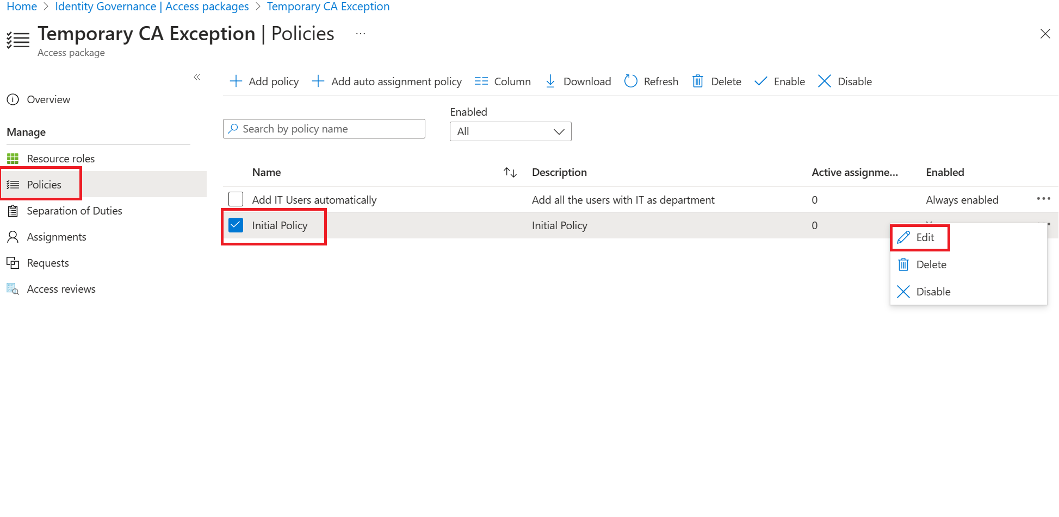
Step 4 Trigger Logic App from the Access Package
Select Policies on the left menu
Select Initial Policy
Select the 3 points and select Edit

Slide 57
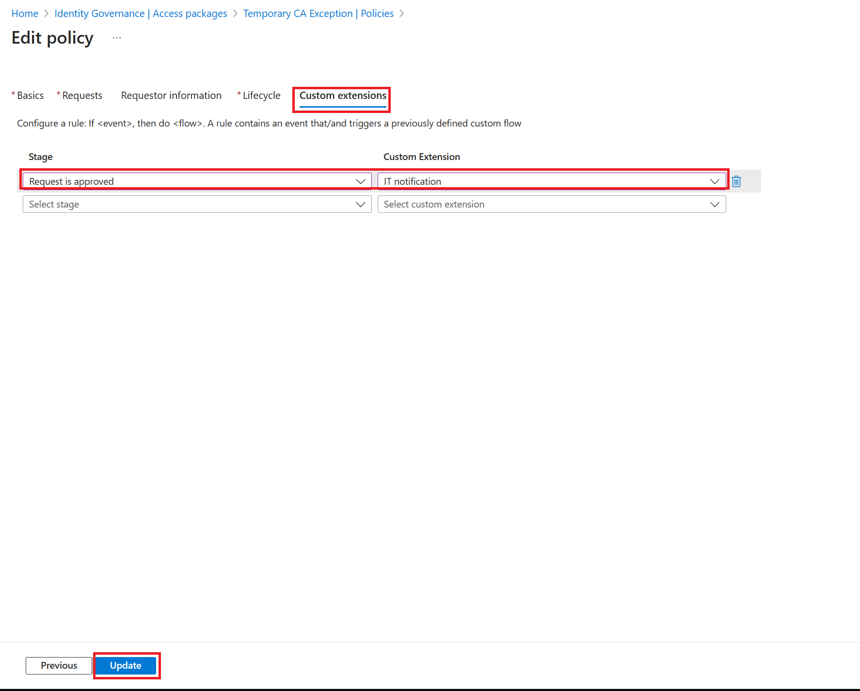
Step 4 Trigger Logic App from the Access Package
Go to Custom Extensions tab
Select Request is approved as stage ok
Select IT notification as Custom Extension
Select Update

Slide 58

Thank you

